Slide 1
Lists, Sets

Slide 2
Data structures
Complex structures to store a bunch of data
Eg: lists, sets, maps, trees, stacks, graphs, queues...
Notes:
Arrays and n dimension arrays are also data structures.

Slide 3
Data structures
Knowing them is as important as knowing basic algorithms
List, Map: 5-10 u/d
Notes:
u/d = usage / day

Slide 4
Java Collection framework
Contains classes for several different data-structures
Different types of data-structures as well as different implementations of a given data-structure
Contains Interfaces, and utility-classes
Has mostly generic classes

Slide 5
Interface (a very short intro)
A class which contains only method signatures (not body)
http://hg.openjdk.java.net/jdk8/jdk8/jdk/file/tip/src/share/classes/java/util/List.java
A class can implement an interface
https://hg.openjdk.java.net/jdk8/jdk8/jdk/file/tip/src/share/classes/java/util/ArrayList.java
When a class implements an interface it must have all the methods of the interface (with body)

Slide 6
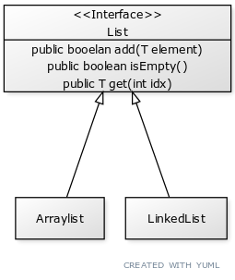
Interface in UML

Slide 7
Generics (a very short intro)
Generic: a type (class), or a method parameterized with another class
http://hg.openjdk.java.net/jdk8/jdk8/jdk/file/tip/src/share/classes/java/util/List.java
https://hg.openjdk.java.net/jdk8/jdk8/jdk/file/tip/src/share/classes/java/util/ArrayList.java

Slide 8
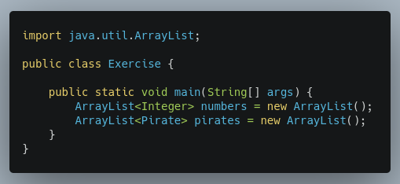
Generics - how we use them
Will contain numbers
Will contain Pirates

Slide 9

Lists
Think of them as extendible arrays
Can be indexed (with the get method)
Preserves order (of additions)
The add method adds an element to the end of the list
Allows duplicates
https://docs.oracle.com/javase/8/docs/api/java/util/List.html

Slide 10
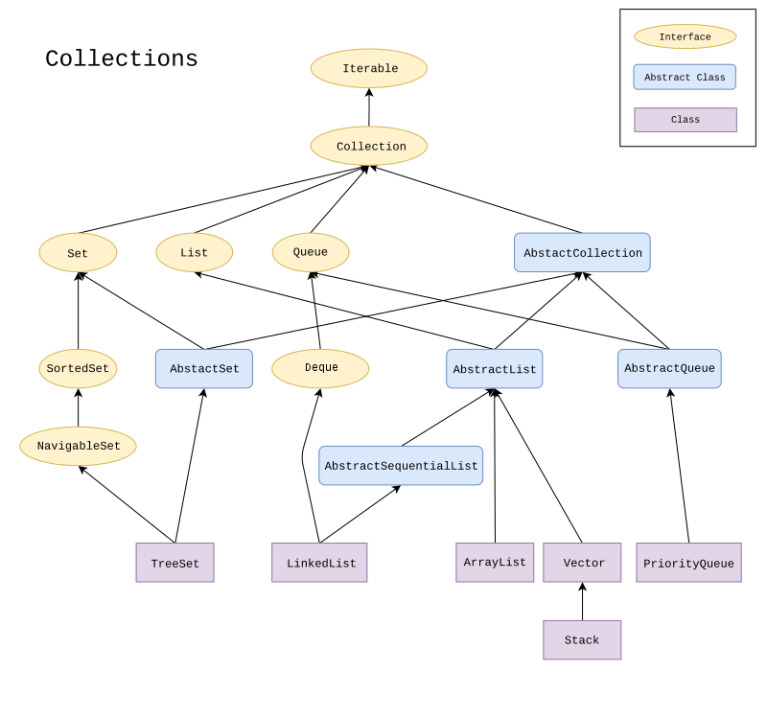
https://en.wikipedia.org/wiki/Java_collections_framework#/media/File:Java.util.Collection_hierarchy.svg

Slide 11
ArrayList
A list implemented with an array inside

Slide 12
Exercise
Create a Person class that contains name, age, weight, height of a person,
Create an ArrayList that stores Persons.
Write a method that calculates
The Person with minimum weight.
The sum height of each persons.
The average age of all persons

Slide 13
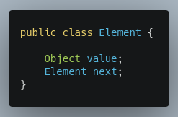
Linked List

Slide 14
Linked List vs ArrayList
 | ArrayList | LinkedList
get(int i) | ϴ(1) | ϴ(n)
add(T elem) | ϴ(1) normally, ϴ(n) when array grows | ϴ(1)
remove(int index) | ϴ(n) | ϴ(n)
getFirst(), getLast() |  | ϴ(1)
iterating over the list | ϴ(n) | ϴ(n)
add(int index, E element) | ϴ(n) | ϴ(n)

Slide 15
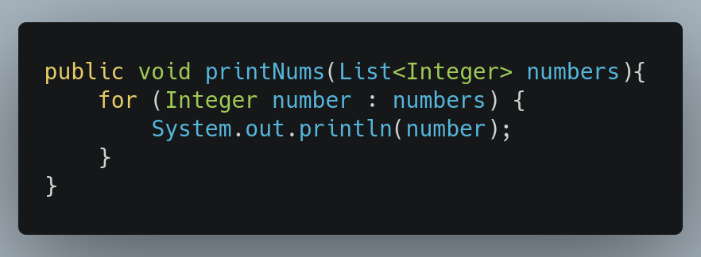
Foreach

Slide 16
Iterator, listiterator
Collections are iterable
They have an iterator() method which returns and Iterator object
Iterators are used to traverse a collection (and at the same time modify them)

Slide 17
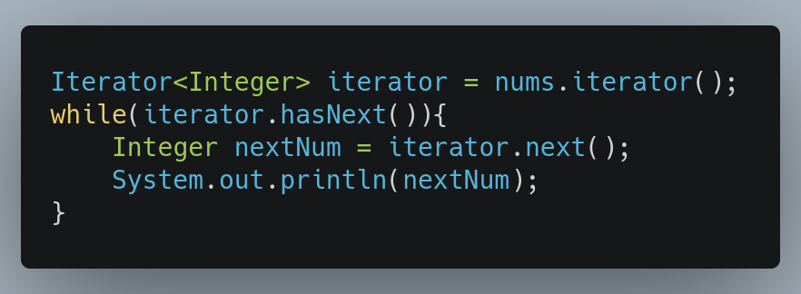
Iterator - hasNext(), next()

Slide 18

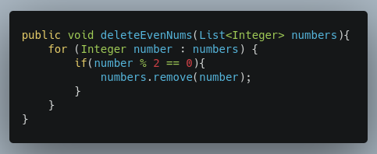
How not to cut the tree underneath yourself
https://whatsupwithamsterdam.com/the-mystery-of-the-sculptures/

Slide 19
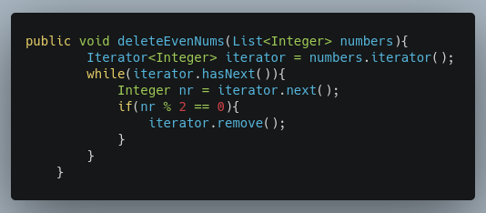
How not to cut the tree underneath yourself - iterator.remove()
✓

Slide 20
Foreach and the iterator
Iterator is actually the stuff behind foreach…
You can only use foreach on objects which have an interator() method.
foreach is just a shorthand of iterating with iterators…
But with foreach you cannot delete or modify the collection.

Slide 21
Listiterators
List have an enhanced iterator: listIterator
Supports
traversal in both directions (forward and backward
modify the list (set a new value)
obtain current index
https://docs.oracle.com/javase/8/docs/api/java/util/ListIterator.html

Slide 22
Exercise
Write the deleteEvenNums(List<Integer> nums) method with a fori loop for (int i=0; i<nums.size(); i++) and see what happens!
Write it in the ways described above (with for each and with iterators) and see what happens!

Slide 23
Sets
Set is a collection which does not permit duplicates.
1
1
5
5
3
5
10
10
11
11
SET
NOT A SET

Slide 24
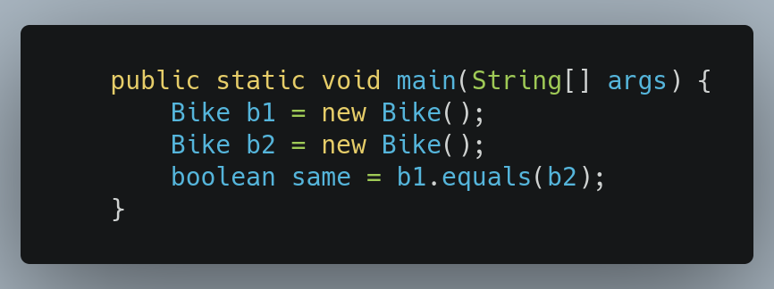
What is a duplicate
What is same?
When two objects are the same?
If their equals method returns true
Every class have and equals method.
By default equals returns true, only if the two variables refer to the same object.

Slide 25
Sets
https://docs.oracle.com/javase/8/docs/api/java/util/Set.html

Slide 26
Set implementations
HashSet
Do not guarantee iteration order
LinkedHashSet
Gurantees that iteration order is the same as order of insertion
TreeSet
Ordered set (see later)

Slide 27
List<Integer> nums = new ArrayList();
deleteEvenNums(nums);
public void deleteEvenNums(List<Integer> numbers){
numbers.add(3);
}
nums
numbers
Stack
ArrayList
3

Slide 28
public static void maint(String[] args){
List<Integer> nums = new ArrayList();
deleteEvenNums(nums);
}
public void deleteEvenNums(List<Integer> numbers){
numbers = new ArrayList();
}
nums
numbers
Stack
ArrayList
ArrayList
3

Slide 29
public static void maint(String[] args){
List<Integer> nums = new ArrayList();
deleteEvenNums(nums);
}
public void deleteEvenNums(List<Integer> numbers){
numbers = new ArrayList();
List<Integer> szamok = new ArrayList();
szamok = numbers;
}
nums
szamok
numbers
Stack
ArrayList
ArrayList
ArrayList
3

Slide 30
public static void maint(String[] args){
int a = 1;
increase(a);
sout(a);
}
public void increase(int nr){
nr++;
}
Stack
a - 1
nr - 1
nr - 2

